Slide 1



Software Engineering
Lecture 3: Requirements Engineering: Process, Elicitation Techniques
Prof. Mohamad Kassab m.kassab@nyu.edu

Slide 2
Lesson outline
What is Requirements Engineering?
What is a requirement?
Requirements Classifications
Who is a Requirements Engineer?
Requirements Elicitation Techniques
Context Diagram

Slide 3

What is requirements engineering?

Slide 4
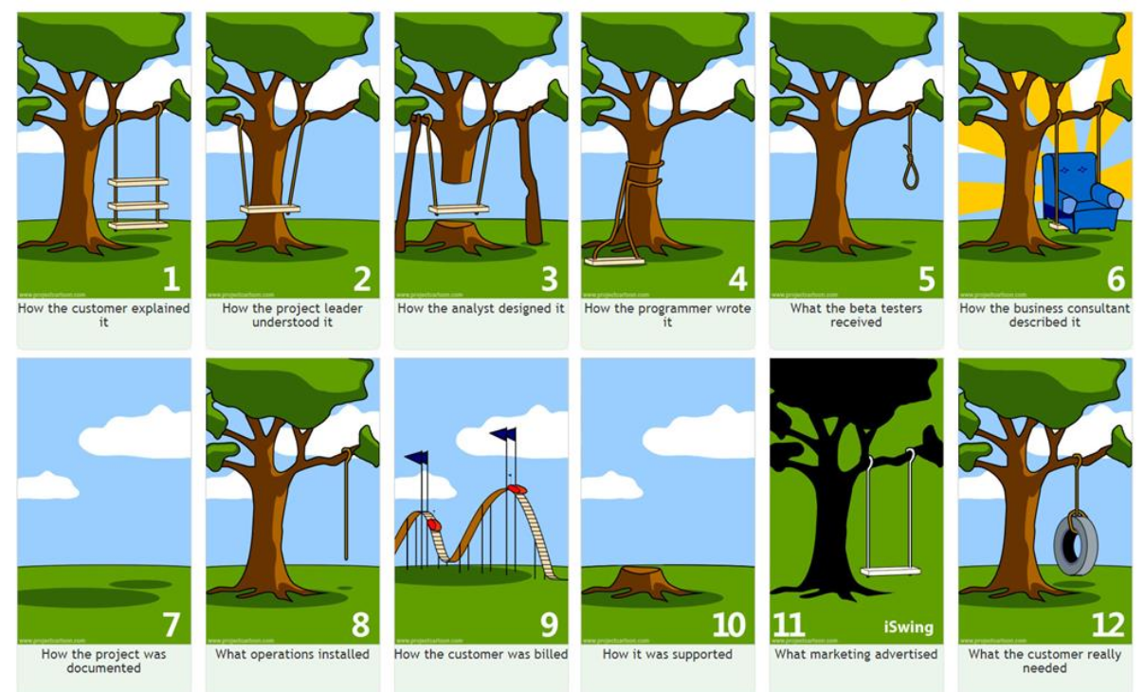

Slide 5
What is Requirements Engineering?
What is requirements Engineering?
“Requirements engineering is the branch of software engineering concerned with the real-world goals for, functions of, and constraints on software systems. It is also concerned with the relationship of these factors to precise specifications of software behavior, and to their evolution over time and across software families.” (Zave, 1997)

Slide 6
Requirements Engineering Activities
Requirements elicitation/discovery
Requirements analysis and reconciliation
Requirements representation/modeling
Requirements verification and validation
Requirements management
There are others, but these are the “major” ones

Slide 7

What are Requirements?
A requirement is a documented description of a feature, functionality, or characteristic that a system or product must possess to fulfill stakeholders' needs and expectations.
Requirements serve as the foundation for the design, development, and testing of a system, ensuring that the final product meets its intended purpose.

Slide 8
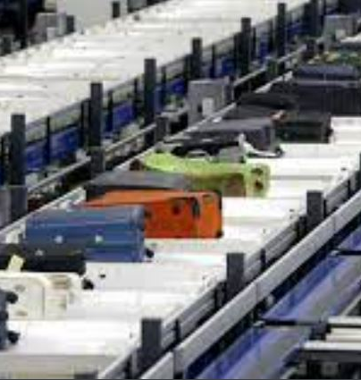

Business Goals VS. Requirements
We discussed business goals during the last session. These Provide overarching purpose “project metaphor”
Business Goal for “Baggage Handling System”: To automate all aspects of baggage handling from passenger origin to destination.
On the other hand, requirements are more specific and are refined from Business Goals

Slide 9
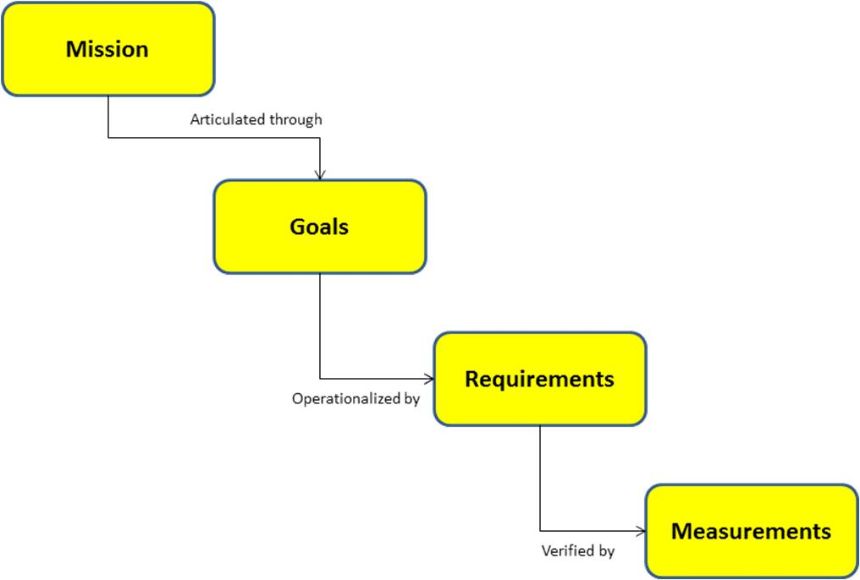
Goals versus Requirements

Slide 10

Possible classification for requirements:
Functional requirements
Non-functional requirements (NFRs)

Slide 11
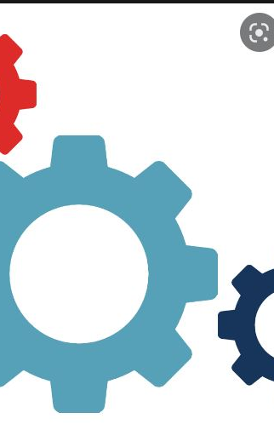
Functional Requirements
The services the system should provide.
How it will react to inputs.
Need to explicitly state what the system should not do.
Can be high-level and general (user requirements) or detailed, expressing inputs, outputs, exceptions, etc. (system requirements).
Many forms of representation from NL, visual models, to formal methods.

Slide 12

Non-functional Requirements (NFRs)
Requirement imposed by the environment in which the system is to exist.
This includes timing constraints, quality properties, standard adherence, programming languages to be used, etc.
Some of these non-functional requirements are counter intuitive (e.g., timing).
More on NFRs later in the course.

Slide 13
Functional Requirements for Baggage Handling System (1)
Baggage Check-in:
The system must allow passengers to check in their baggage through self-service kiosks.
Baggage information (weight, size, destination) must be captured during the check-in process.
Baggage Sorting:
The system must automatically sort baggage based on destination and flight.
Baggage sorting should prioritize special handling requirements (fragile, priority, etc.).
Baggage Tracking:
The system must provide real-time tracking information to passengers regarding the location of their baggage.
Baggage status updates, including transfers and arrivals, must be accessible through a mobile application and airport displays.

Slide 14
Functional Requirements for Baggage Handling System (2)
Security Checks:
Baggage must undergo security screening in compliance with aviation regulations.
The system must flag and notify security personnel of any suspicious items detected during screening.
Transfer Handling:
The system must facilitate smooth transfers of baggage between connecting flights.
Transfer times and processes should be optimized to minimize the risk of missed connections.
Baggage Claim:
Baggage must be automatically routed to the correct baggage claim area.
Passengers must receive timely notifications on the arrival and location of their baggage at the designated claim carousel.

Slide 15
NFRS FOR BAGGAGE HANDLING SYSTEM (1)
Reliability:
The baggage handling system must have a reliability rate of 99.9%, minimizing the risk of lost or mishandled baggage.
Performance:
Baggage processing times, from check-in to claim, must not exceed 30 minutes on average.
The system must handle a peak load of 1,000 baggage transactions per hour during high-traffic periods.
Scalability:
The system must scale to accommodate the growth in passenger numbers, supporting at least a 20% increase in capacity within the next five years.

Slide 16
NFRS FOR BAGGAGE HANDLING SYSTEM (2)
Security:
Access to the baggage handling system must be restricted to authorized personnel only.
Data related to passenger baggage must be encrypted and secured to protect sensitive information.
Compliance:
The system must adhere to international aviation and security regulations, including IATA guidelines for baggage handling.

Slide 17

WHO IS THE Requirements Engineer
In companies those hold the positions of:
Requirements Analyst
Product Owner
Project Manager
Software or System Analyst
There are other positions that may have requirements engineering responsibly; for example:
Quality Assurance Analyst
User Experience Designer
Process Improvement Specialist
IT Consultant

Slide 18
WHO IS THE Requirements Engineer
Requirements Engineer should be:
Be a good manager (to manage the process)
Good listener
Fair
Good negotiator
Understand the problem domain
Multidisciplinary (e.g., traditional hard sciences and engineering augmented with communications and management skills)

Slide 19
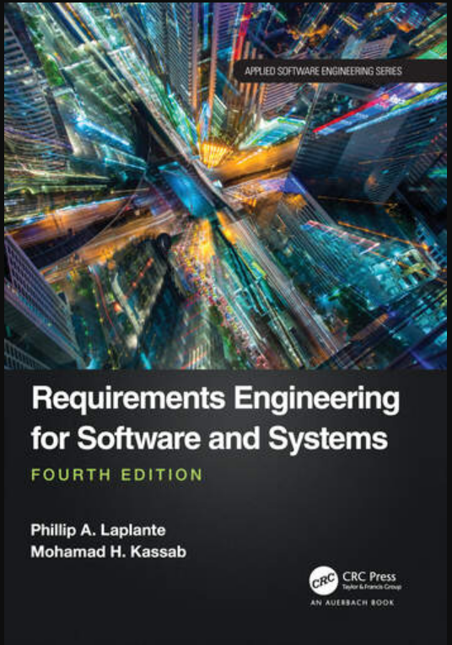
Elicitation Techniques
Requirements Elicitation Techniques
Chapter 3 of Requirements engineering for software and systems Mandatory reading
Brainstorming
Card Sorting
Crowd Sourcing
Designer as Apprentice
Domain Analysis
Ethnographic Observation
Goal Based Approaches
Group Work
Interviews
Introspection
JAD
Laddering
Protocol Analysis
Prototyping
QFD (encompasses card sorting and laddering and domain analysis)
Questionnaires
Repertory Grids
Reverse Engineering
Task Analysis
Scenarios & Use Cases
User Stories
Viewpoints
Workshops

Slide 20

1. brainstorming
Informal gatherings with customers and other stakeholders to generate overarching goals for the systems.
Some preliminary requirements may be generated.
Useful mostly for generating the business goals (mission statement), and high level features of the system.

Slide 21
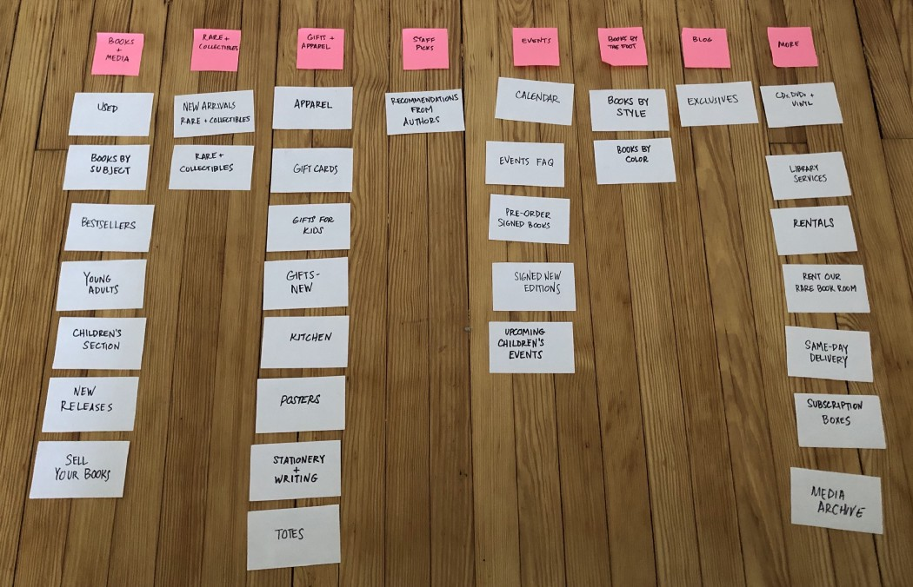
2. Card Sorting
Involves having stakeholders complete a set of cards that include key information about functionality (may include ranking and rationale)
RE then organizes these cards in some manner
The sorted cards can be used as an input to the process to develop CRC (capability, responsibility, class) cards to determine program classes in the eventual code

Slide 22
2. Card Sorting (Point of sale system)
Update inventory records
Priority – High
Identify customer if returning
Priority – High
Manage customer loyalty feature
Priority – Medium
Apply sales tax to non-food items
Priority – Medium
Prepare sales tax reports
Priority – High

Slide 23
2. Card Sorting (Point of sale system)
Customer management
Tax functions
Identify customer if returning
Priority – high
Prepare sales tax reports
Priority – High
Manage customer loyalty feature
Priority – Medium
Apply sales tax to non-food items
Priority – Medium
Inventory features
Update inventory records
Priority – High

Slide 24

3. Domain Analysis
Involves assessing the “landscape” of related and competing applications
Can be useful in identifying essential functionality and later, missing functionality
Can be used downstream for identifying reusable components (e.g., open-source elements)

Slide 25
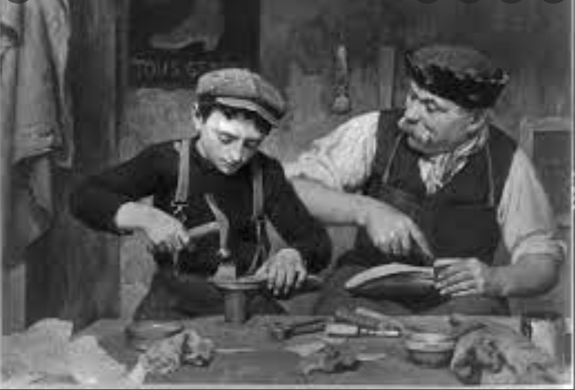
4. Designer as Apprentice
“A new computer system changes how its customers work. Designing such a system requires intimate knowledge of customers' work and motives to ensure that the system supports them well. The creation of a new system implicitly means designing the new work practice it will support…The fundamental problem in the relationship between customers and designers is to enable learning: how do designers learn enough about customers' work to design well?
What kind of relationship allows customers to impart deep knowledge about their work?”
Beyer & Holtzblatt

Slide 26
4. Apprenticeship
The relationship between master craftsman and apprentice stands out as a useful model.
The apprentice learns a skill from the master just as we want the designer to learn about the customers’ work from the customer.

Slide 27
4. Designer as Apprentice
The critical aspects of the relationship are:
Teaching ability is not needed
Seeing the work reveals what matters
Seeing the work reveals details
Seeing the work reveals structure

Slide 28
4. Designer as Apprentice
Customers cannot talk about their work effectively but can talk about it as it unfolds.
Don't have to work out the best way to present it, or the motives; they just explain what they’re doing.
“I’m scanning each product as it comes down the conveyor belt. If there are multiples of any one product I enter the number of same items, press the # key, then enter the price and press ‘total’..."

Slide 29
4. Designer as Apprentice
People are not aware of everything they do and sometimes why they do it.
Some actions are result of years of experience and have subtle reasons; others are habit and no longer have a valid justification.
The presence of an apprentice provides the opportunity for the master (customer) to think about the activities and how they came about.

Slide 30
4. Designer as Apprentice
Patterns of working are not always obvious to the worker.
An apprentice learns the strategies and techniques of work by observing multiple instances of a task and forming an understanding of how to do it themselves, incorporating the variations.

Slide 31

5. Ethnographic Observation
Based on detailed (at the level of a social scientist) observations of human activity.
Involves long periods of observation (hence, an objection)
Direct and indirect evidence is gathered
The work or activity itself
Evidence derived from the surroundings that may not be communicated directly
Designer as Apprentice is a special case of ethnographic approach

Slide 32
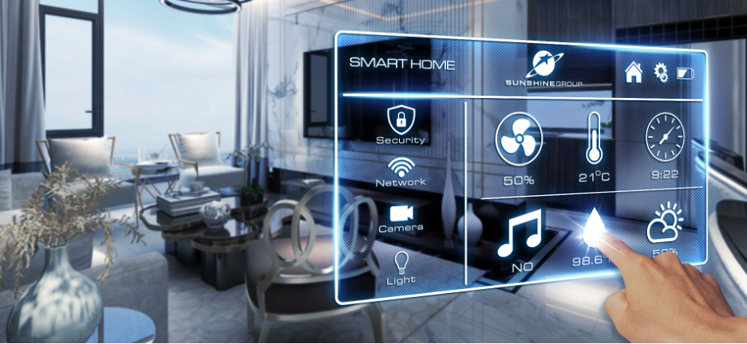
5. Ethnographic Observation
Consider gathering requirements for a smart system.
You spend long periods of time interviewing the customer about what she wants
You spend time interacting with the customer as she goes about her day and ask questions (“why are you running the dishwasher at night, why not in the morning?”)
You spend long periods of time passively observing the customer “in action” in their current home to get non-verbal clues about her wants and desires
You gain other information from the home itself – the books on the book shelf, paintings on the wall, furniture styles, evidence of hobbies, signs of wear and tear on various appliances, etc.
Notes:
**Heisenberg Uncertainty Principle is a challenge with this technique.

Slide 33

6. Goal Based Approaches
Start from mission statement and provides lower level goals brought.
Lower-level goals are then branched out into specific high-level requirements.
High-level requirements then generate lower-level ones.

Slide 34

6. Goal Based Approaches: Baggage Handling System
Mission Statement: “To automate all aspects of baggage handling from passenger origin to destination.”
Goal 1: To completely automate the tracking of baggage from check in to pick up
Goal 2: To completely automate the routing of baggage from check in counter to plane
Goal 3: To reduce the amount of lost luggage to .1%...

Slide 35

7. Group Work
General term for any kind of group meetings
Difficult to organize and focus the many stakeholders involved
Problems of openness and candor can occur
Certain individuals can dominate
Can lead to feelings of being “left out”
RE must be very skillful in leading these sessions to avoid such problems

Slide 36

8. Interviews
Obvious and easy to use technique
Three kinds of interviews exist
Unstructured – conversational, can be hit-or-miss based on skill of interviewer
Structured – uses pre-defined questions that have been rigorously planned
Semi-structured – uses combination of the above
Care must be taken to ensure all of the right questions are asked
Templates are very helpful when in employed with interviewing

Slide 37
8. INTERVIEWS: Sample Questions
Name an essential feature of the system? Why is this feature important?
How important is this feature with respect to other features?
What other features are dependent of this feature?
What other features must be independent of this feature?
What other observations can you make about this feature?

Slide 38

9. Introspection
RE develops requirements based on what he “thinks” the customer wants
Think of : Building a “Chess Game”
Useful when the RE’s domain knowledge far exceeds the customers’
Introspection is probably to be avoided in cases where the customer has experience in the domain

Slide 39
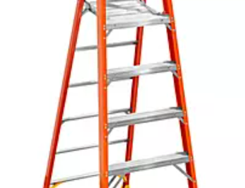
10. Laddering
Uses short prompting questions (“probes”) to elicit requirements
Follow up questions dig deeper below the surface
Assumes that information can be arranged in a hierarchical fashion
Resultant information is then organized in some kind of tree structure

Slide 40
10. Laddering: Point of sale system
Name a key feature of the system?
Customer identification
How do you identify a customer?
They can swipe their loyalty card
What if a customer forgets their card?
They can be looked up by phone number
When do you get the customer’s phone number?
When they complete the application for the loyalty card
How do they complete the applications….

Slide 41
10. Laddering
Customer loyalty management
Application processing
Customer identification
Swipe card processing
Customer id lookup

Slide 42
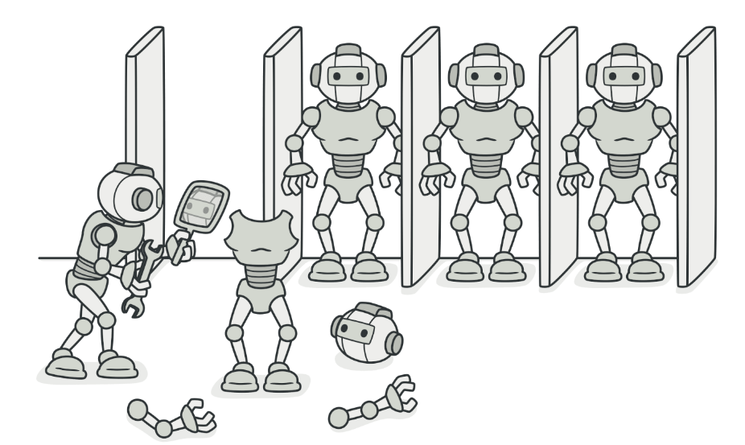
11. Prototyping
Involves construction of models of the code in order to discover new features
Can involving working models (code) as well as non-working (storyboards, GUIs)
Code can be throwaway and non-throwaway
Architects use prototyping in the manner described previously
Agile development consists of an ever-evolving non-throwaway prototype
Notes:
At least three dangers when using prototyping for requirements elicitation.

Slide 43

12. Questionnaires
Straightforward technique consisting of survey instruments
Used at early stages to quickly define the scope boundaries
Survey questions can be closed (e.g., multiple choice, true false) or open-ended
Danger in over-scoping and under-scoping if questions are not adequately framed
Therefore, most useful when the domain is very well understood by both stakeholders and RE

Slide 44
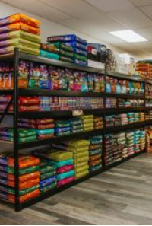
12. Questionnaires: Some Questions for Point of sale system
How many unique products (SKUs) do you carry in your inventory
a) 0-1000 b) 1001-10,000 c) 10,001-100,000 d) > 100,000
How many different warehouse sites do you have? ____
How many different store locations do you have? ____
How many unique customers do you currently have? ____

Slide 45
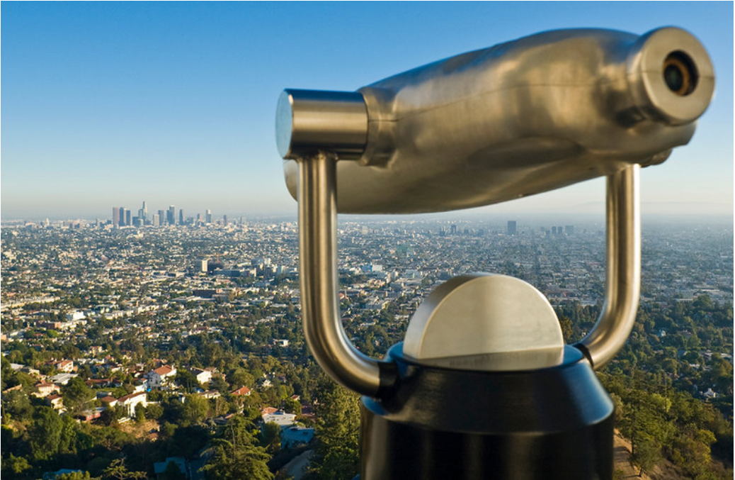
13. Viewpoints
A way to organize information from the (point of view) of different constituencies.
Various formats and applications for viewpoints in software and systems engineering
In RE used for prioritization, agreement, and ordering of requirements
Viewpoints incorporate a variety of information from business domain, process models, functional requirements specs, organizational models, etc.
Viewpoints are generated for each view, and then reconciled using various approaches

Slide 46

14. Workshops
Formal and informal gatherings of stakeholders to hammer out requirements issues
Formal workshops are well planned but can be boring and tiring
Informal workshops can be more lively, but overlook important elements

Slide 47
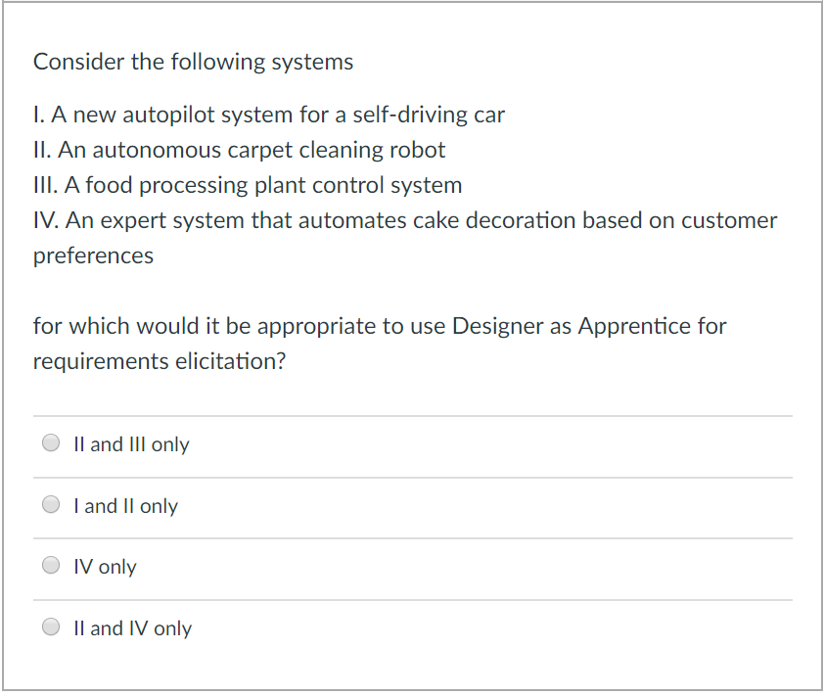
Knowledge Check

Slide 48
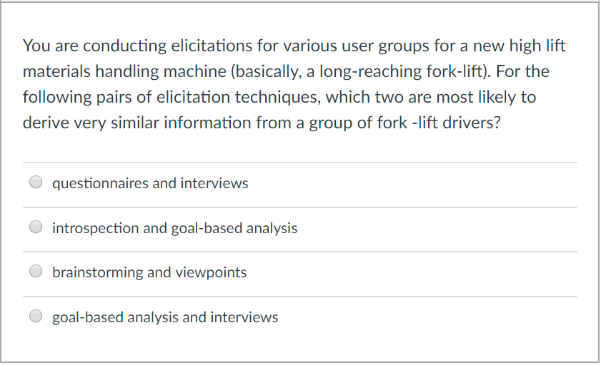
Knowledge Check

Slide 49
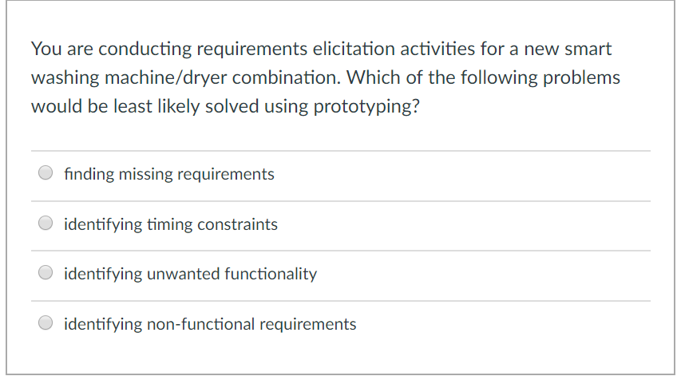
Knowledge Check

Slide 50
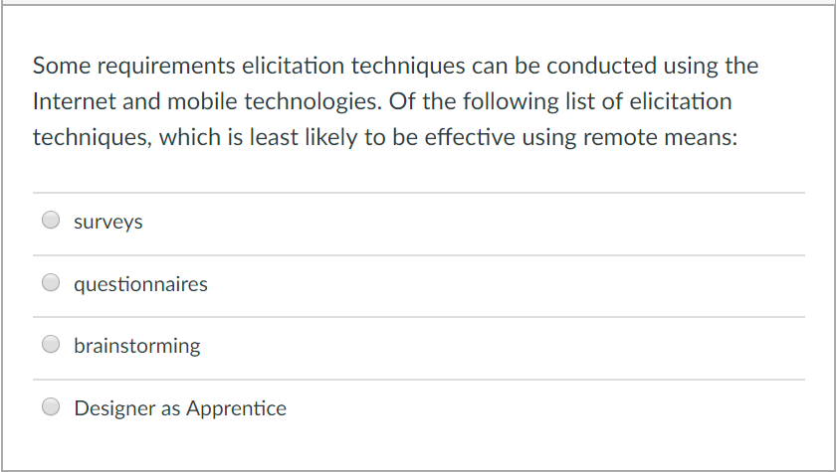
Knowledge Check

Slide 51
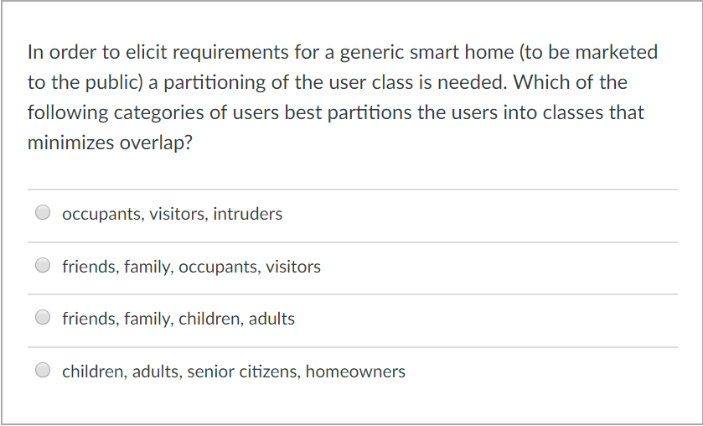
Knowledge Check

Slide 52

Elicitation Summary
All these techniques have advantages and disadvantages (partially discussed)
Some are too general, some too specific, some rely too much on stakeholder knowledge, some not enough, etc.
Combination of techniques really the best way to go
We can group techniques in the following categories (interviews, domain-oriented, group-work, ethnography, prototyping, goals, scenarios, viewpoints)
Following tables show relationships between technique groups

Slide 53

IMPORTANT… Keep in mind…. What the system boundary is…

Slide 54
Context Diagrams
Show the system boundary
The environment with which the system interacts
External interfaces
Others systems on which it relies
Indicate what the system’s environment is
May include users with different roles
May include other computing systems
Environment may be very simple, or very complex
May have multiple context diagrams
Different context diagrams for different views
Usually given for C&C view

Slide 55
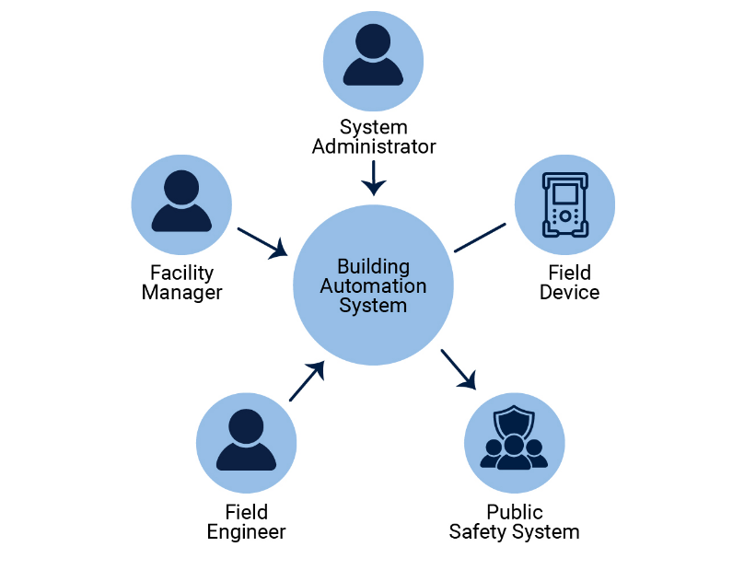
Context Diagram – Example 1

Slide 56
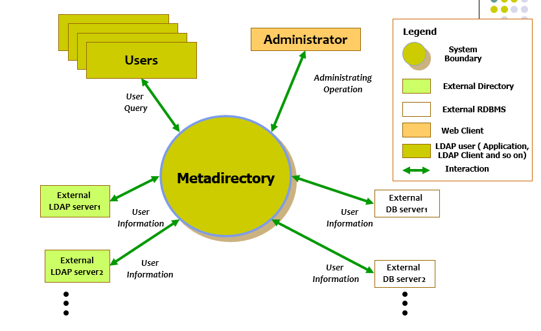
Context Diagram – Example 2

Slide 57
Context May be Complex

Slide 58
Tools to assist in requirements elicitations
Mind Mapping tools (e.g., https://www.mindmup.com/)
GPTs (e.g., AlphaReq)

Slide 59


Readings , Assignments, Project Tasks
Read:
Requirements Elicitation Techniques (Mandatory Reading available in Supplemental Readings folder)
Chapters 7, 8 of the textbook.
Assignments & Project Tasks:
The project is open. Continue forming the teams and working on Project Deliverable 1 (Deadline: 31/1/2025).
Assignment 1 is open. This is an individual Assignment. (Deadline: 07/2/2025)

Slide 60

Questions?

